Slide 1
STATE OF RHODE ISLAND
ATHLETIC LICENSING PROCESS

Slide 2
ATHLETIC LICENSING PROCESS
TO OBTAIN YOUR ATHLETIC LICENSE
ALL ATHLETIC LICENSING IS NOW COMPLETED ONLINE. individuals must log IN to the state’s website following all instructions in order to obtain a license for the calendar year. All licenses will expire on 12/31. The correct website’s address is: www.elicensing.ri.gov/
YOU WILL BE ASKED TO REGISTER AS A FIRST TIME APPLICANT OR AS A RENEWAL. Always apply as a first time applicant, never a renewal.

Slide 3
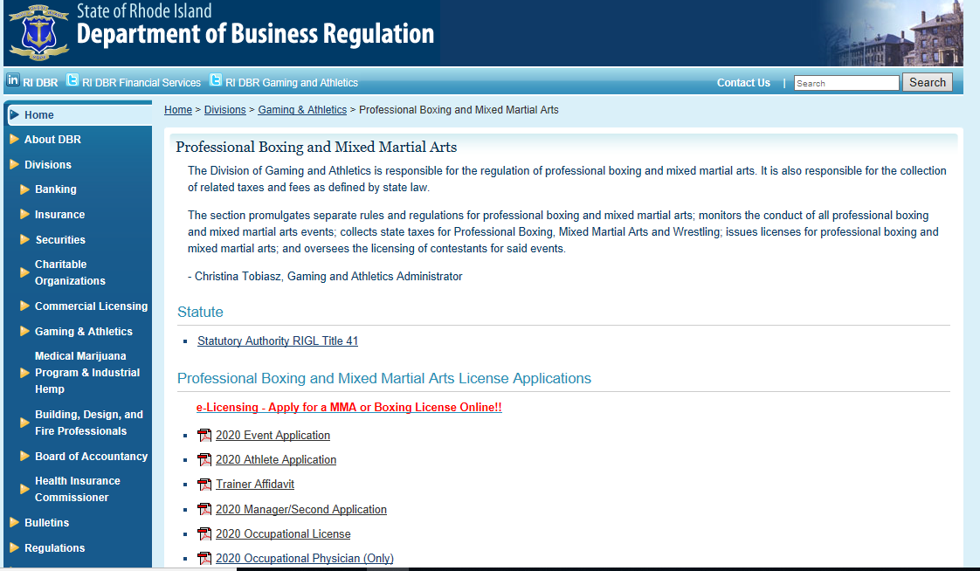

Slide 4
ATHLETIC LICENSING PROCESS
YOU MAY ALSO ENTER THE ELICENSING SCREEN THROUGH THE DBR WEBSITE @ https://dbr.ri.gov/ THEN CLICKING ON GAMING & ATHLETICS, THEN ON PROFESSIONAL BOXING & MIXED MARTIAL ARTS. YOU WILL SEE THE FOLLOWING WHICH WILL ALSO send YOU TO THE CORRECT PAGE:
e-Licensing - Apply for a MMA or Boxing License Online!!

Slide 5
ATHLETIC LICENSING PROCESS this presentation has screen shots of each page from the Elicensing website where you would start the application process. Please note all of the individual pages will be in consecutive order to complete the application. You will need to scroll down to find the correct licensed position that you will be applying for. Please see the next page to determine which is the correct license. The positions are as follows:

Slide 6
ATHLETICS – QUALIFIED LICENSE POSITIONS
POSITIONS WITHIN ATHELTICS THAT REQUIRE A LICENSE:
PROMOTERS LICENSE – (PAPER APPLICATION ONLY!)
ATHLETE LICENSE – (BOXER OR MMA COMPETITOR/fighter)
SECONDS LICENSE – (CORNER PERSON)
MANAGER’S LICENSE – (INDIVIDUAL REPRESENTING THE FIGHTER – at the weigh-in the manager will be asked to present the manger/fighter contract – without this the license cannot be issued

Slide 7
ATHLETICS – QUALIFIED LICENSE POSITIONS
REGULATORY – OCCUPATIONAL LICENSES
REFEREE (BOXING & MMA)
JUDGE (BOXING & MMA)
PHYSICIANS (must file all malpractice insurance documentation by email, hand delivery or regular us mail)
Resuscitators, nurse practitioners, first aid instructors
DIVISION INSPECTORS
Next page is the start page, register as a new applicant there.

Slide 8
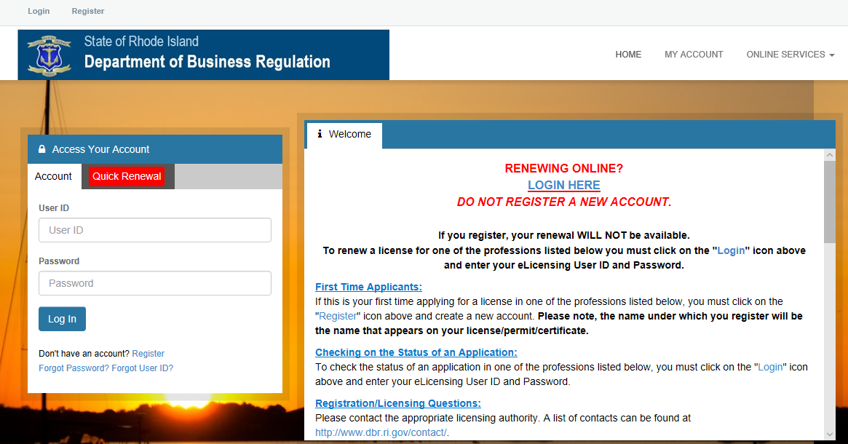
staring page – elicensing website

Slide 9
Registering as a new applicant
The next series of pages will be screen shots of page by page instructions for any individuals registering as a “first time applicant”, CLICK ON REGISTER ICON TO CREATE YOUR ACCOUNT. Most of the pages will be self explanatory.

Slide 10
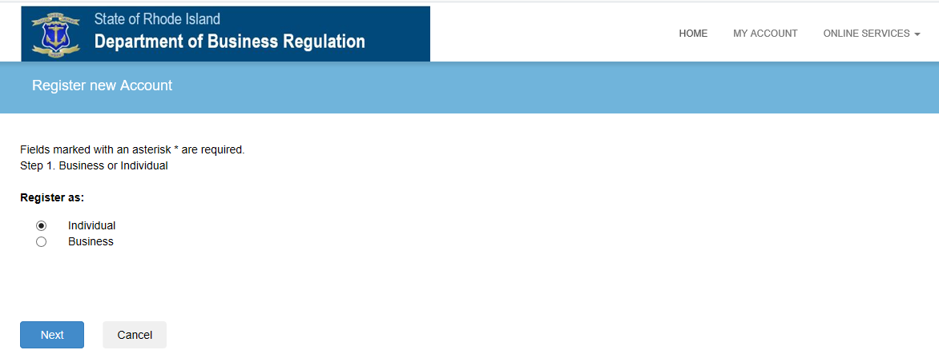

Slide 11
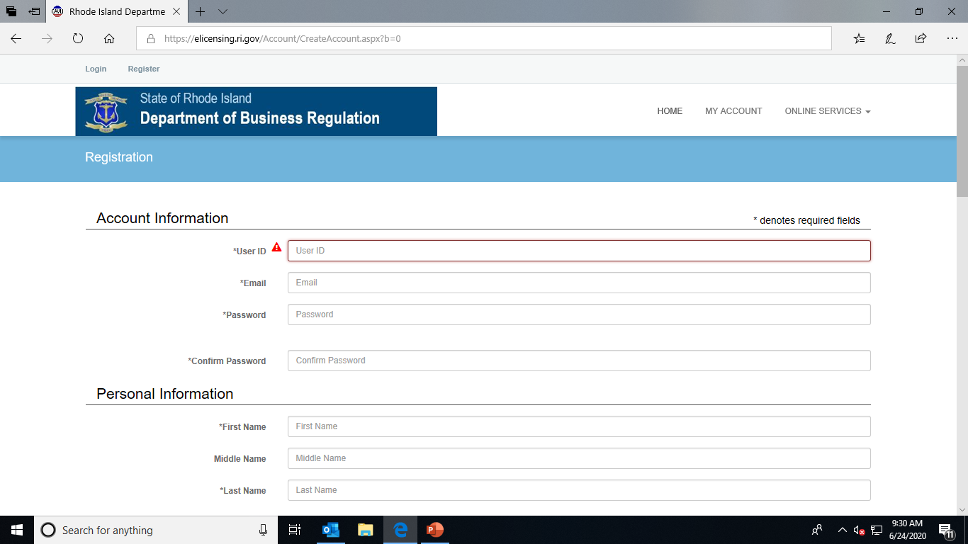

Slide 12
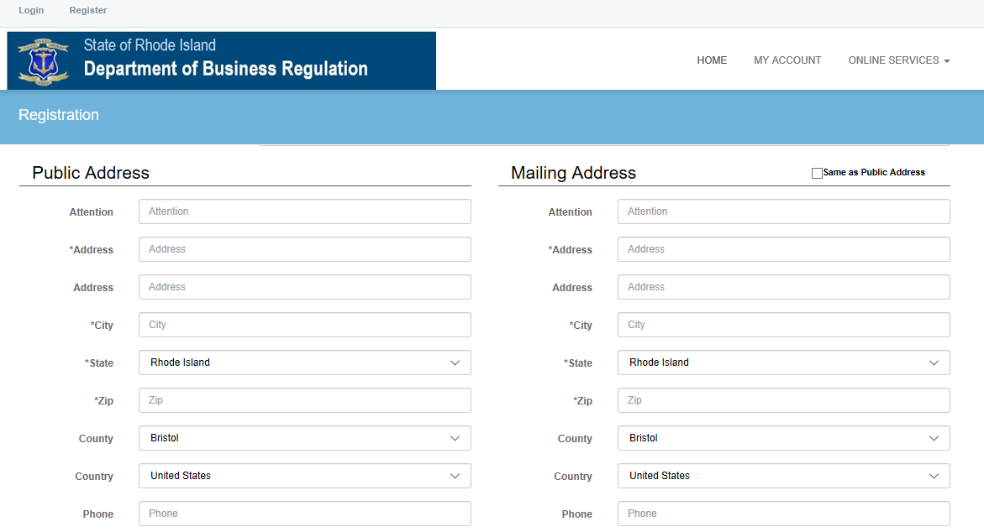

Slide 13
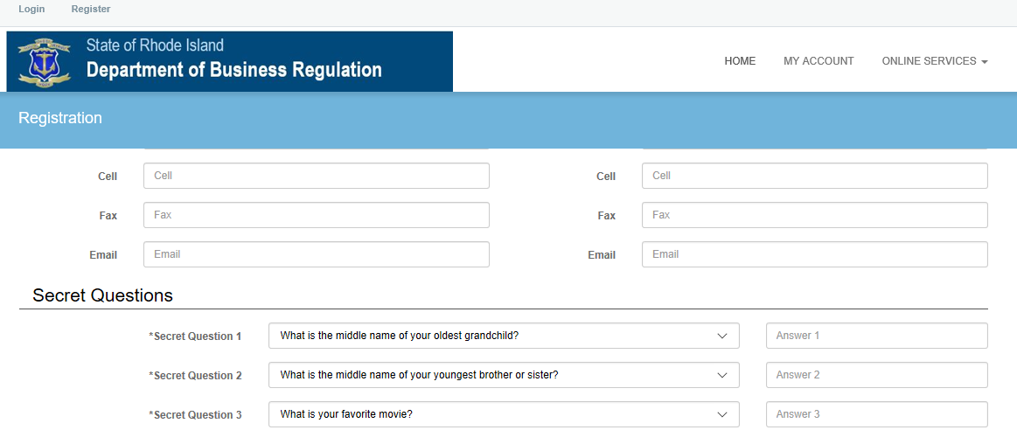

Slide 14
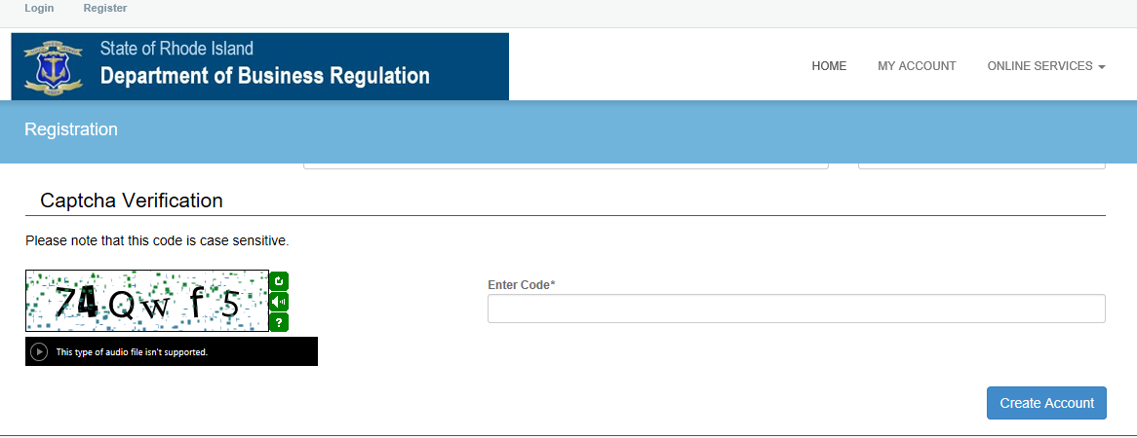

Slide 15
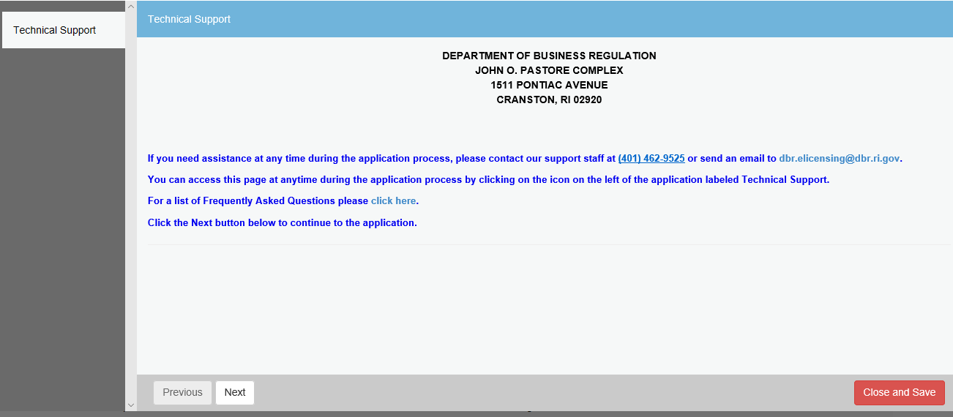

Slide 16
Registering new account – cont.
Upon completion of the first part of the application process, you will need to verify your email address. An email will be sent to you and you must follow all instructions to verify.
below is a copy of the verification email that you will receive to continue the process by clicking on the address:
From: rilicensing@dbr.ri.gov
Date: June 24, 2020 at 10:04:28 AM EDT
To: NAME@YAHOO.COM
Subject: New Account Created
https://elicensing.ri.gov/Account/VerifyEmail.aspx?&guid=e8b5415c-afa4-4cab-9357-31f66de4e2bd&email=NAME@yahoo.com

Slide 17
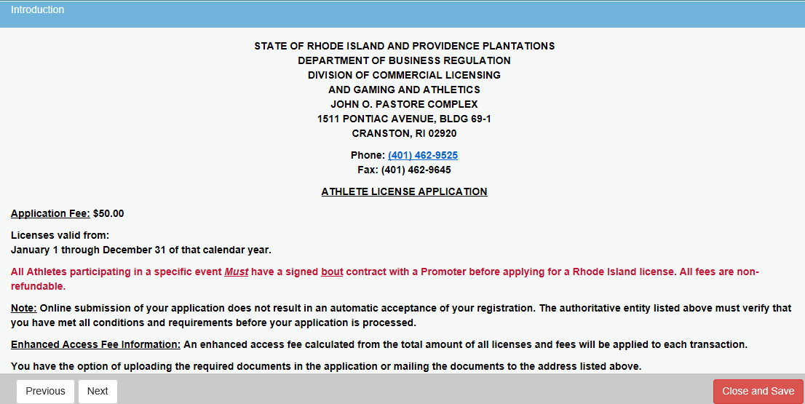

Slide 18
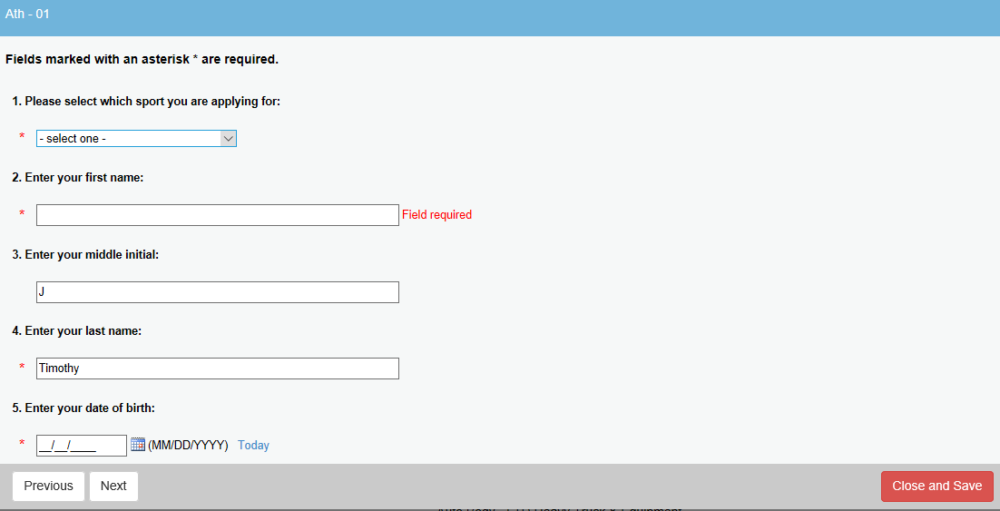

Slide 19
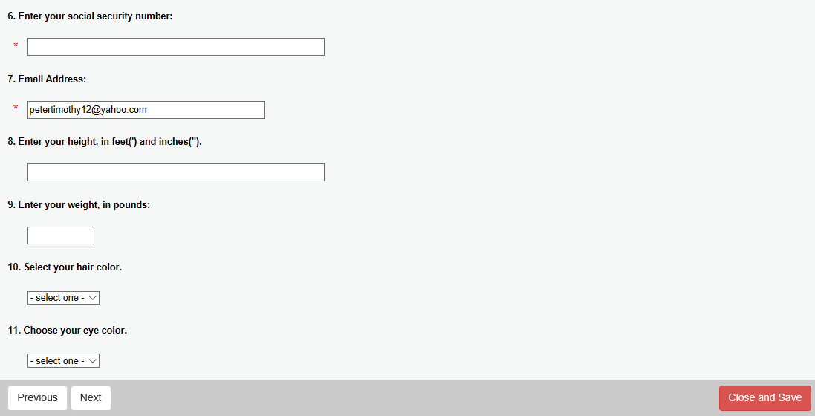

Slide 20
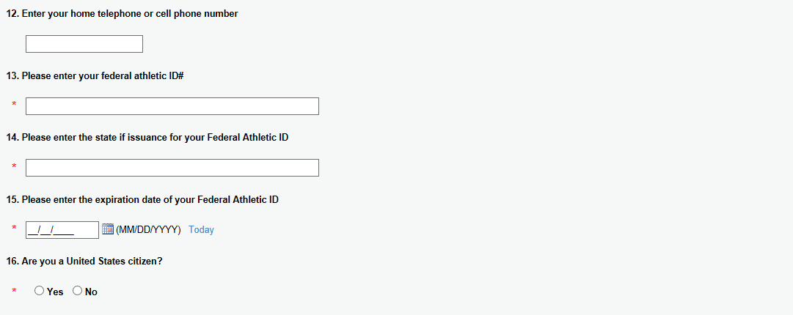

Slide 22
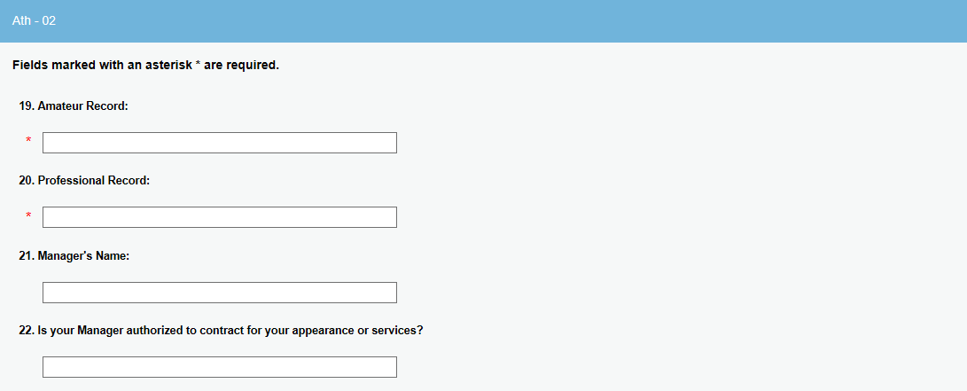

Slide 23
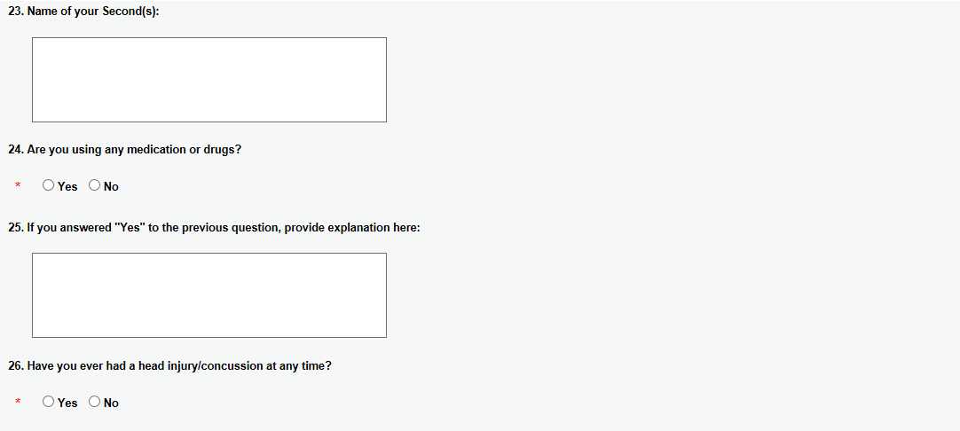

Slide 24
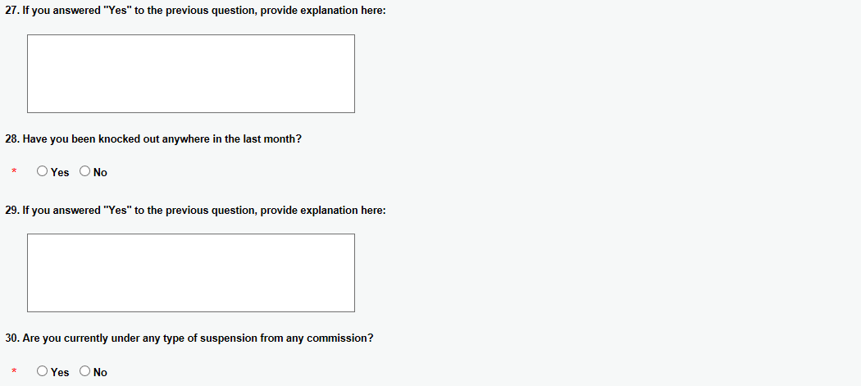

Slide 25
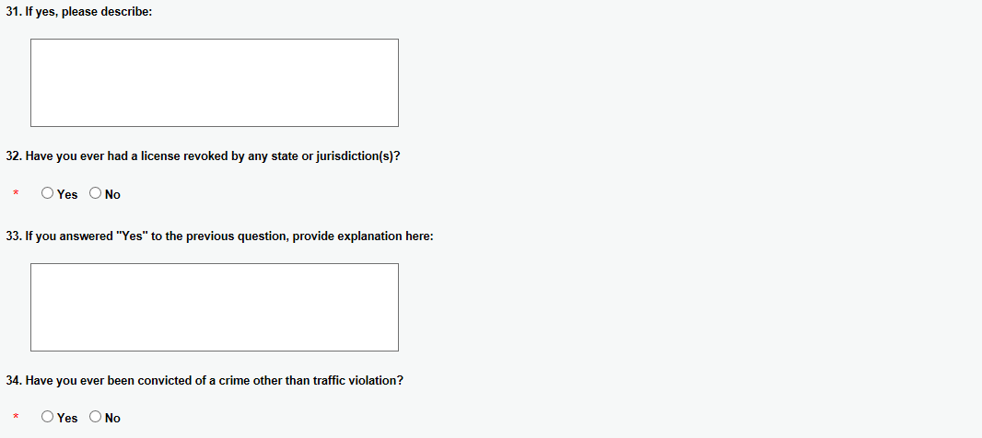

Slide 26
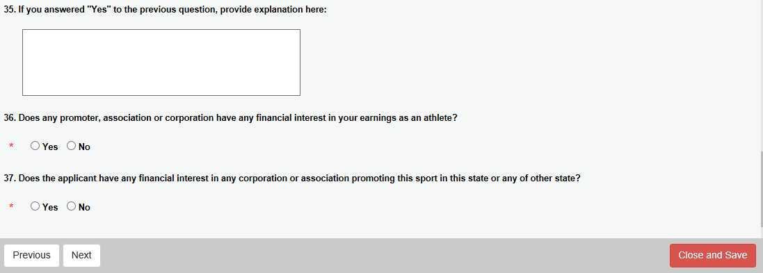

Slide 27
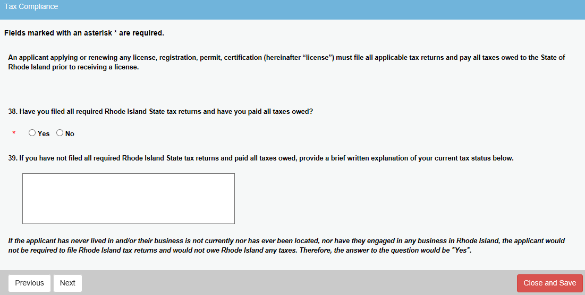

Slide 28
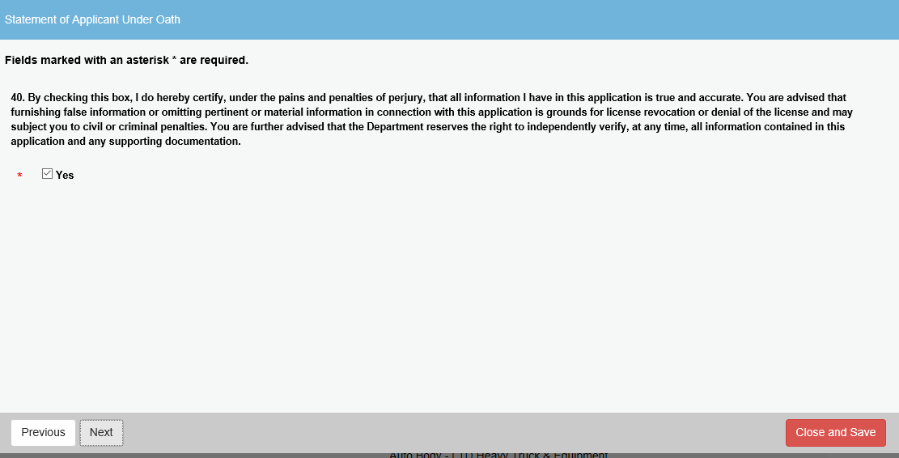

Slide 29
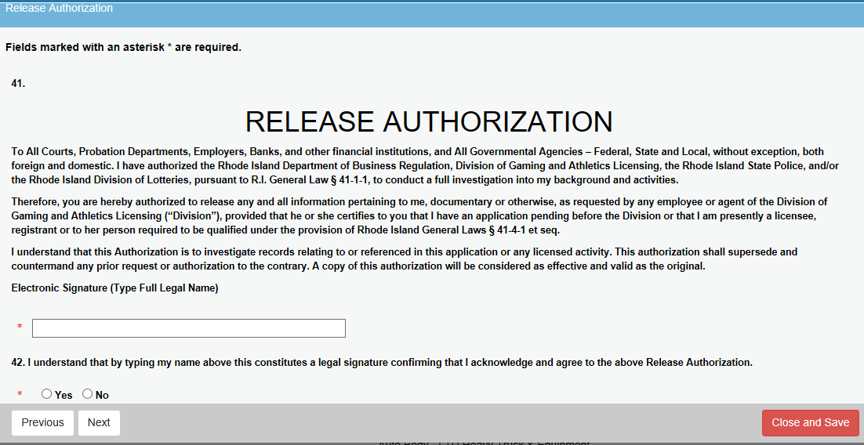

Slide 30
